Slide 1
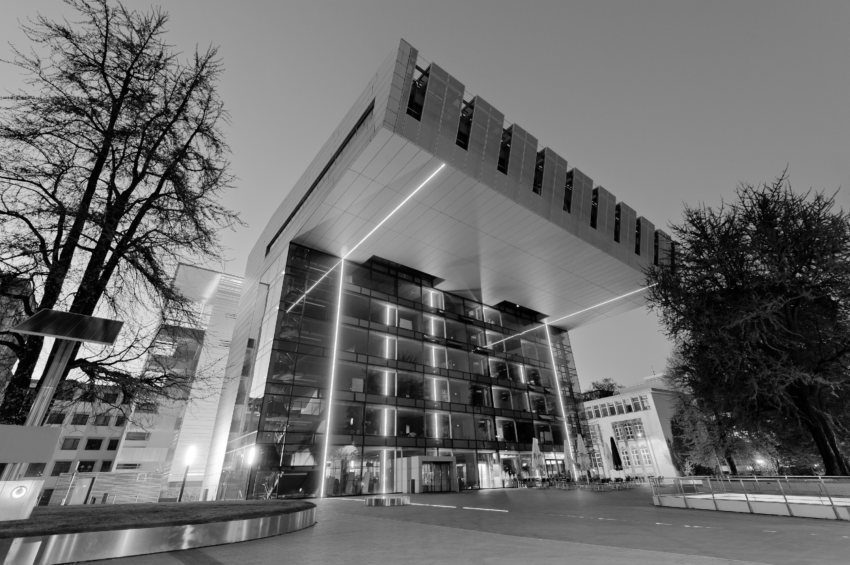

Group 7/8
Aachen
– studibucket –
Team:
Hanna
Ilias
Mahmut
Malek
Aser
Mentor: Simon, Giang

Slide 2
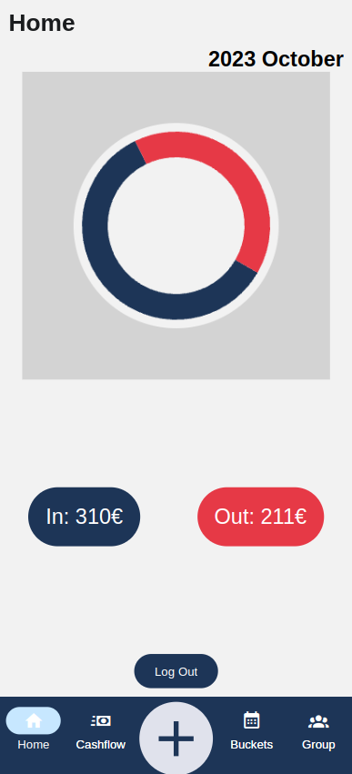
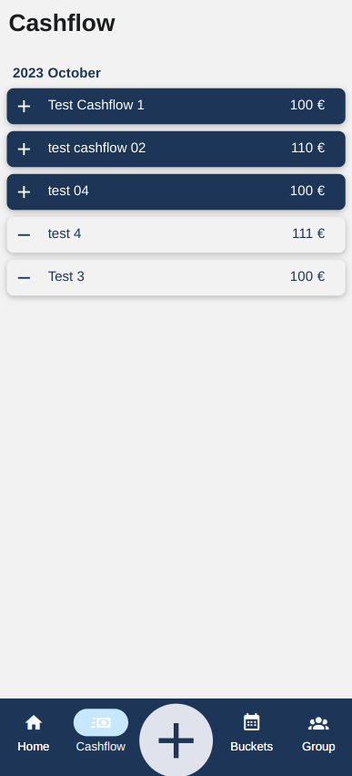
What’s our project about?
A brief description:
A project for students to monitor and plan their finances. Students can:
See / adjust their monthly income
Adjust / monitor their expences
Make saving plans
See / analyse their financial history

Slide 3
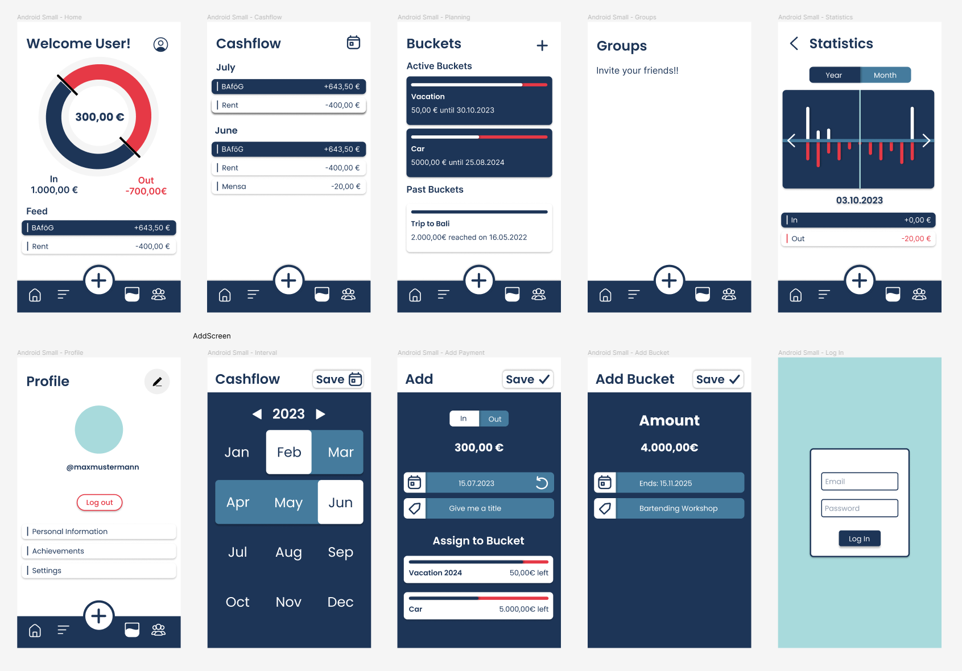
Frontend Design
Designed with Figma

Slide 4
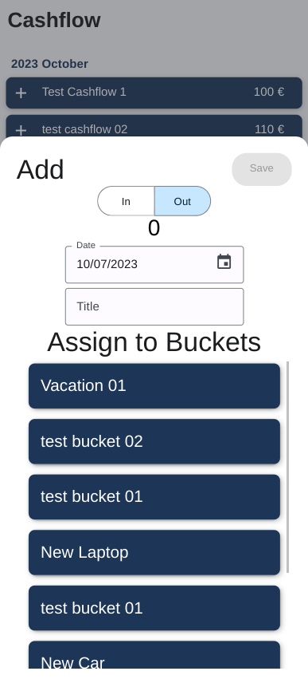
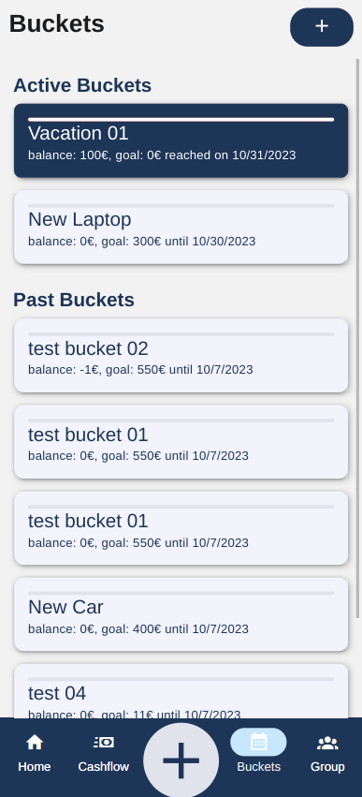
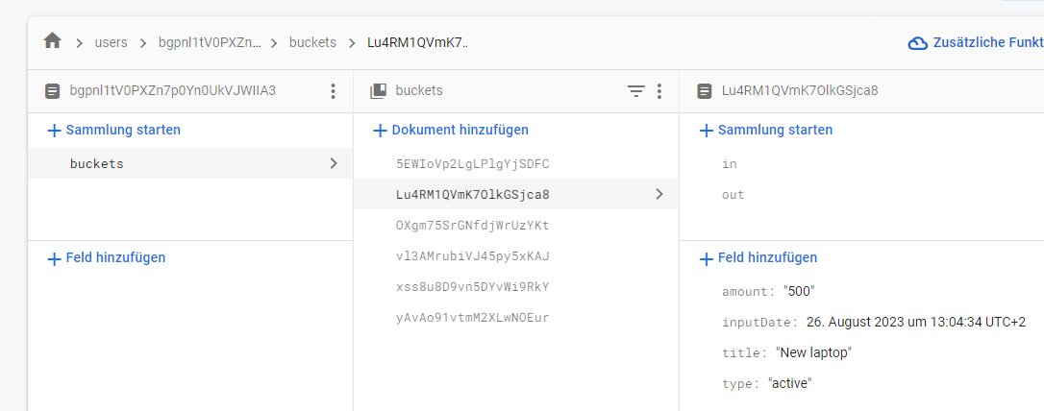
Results
What we have achieved:
Created a fullstack app with firebase backend and react-native frontend

Slide 5
Future Work
What’s next:
Statistics Page
Community Page

Slide 6
Conclusion
Live demo!

